Slide 1

Apple Music

Slide 2
APPLE MUSIC
Apple Music is a music streaming service that Apple Inc. has created. Users can either choose music to stream on-demand to their smartphone or listen to existing playlists. Apple Music 1 and Apple Music Hits, as well as Apple Music Country, are Internet radio stations that transmit live to over 200 countries 24 hours a day. On June 8, 2015, the service was announced, and on June 30, 2015, it went live. Before the service requires a subscription, new subscribers receive a one-month free trial or a six-month free trial with the purchase of chosen products.

Slide 3

User Requirements
Apple Music has a database of Users that stream Songs.
Songs can be searched by the name of an artist, albums and name of the song itself.
For the user to stream songs, the user has to subscribe to different plans.
This transaction is also recorded.
Data to be recorded for particular entities that are mentioned in the below slides.
User Activity such as songs that user listens to is recorded.

Slide 4
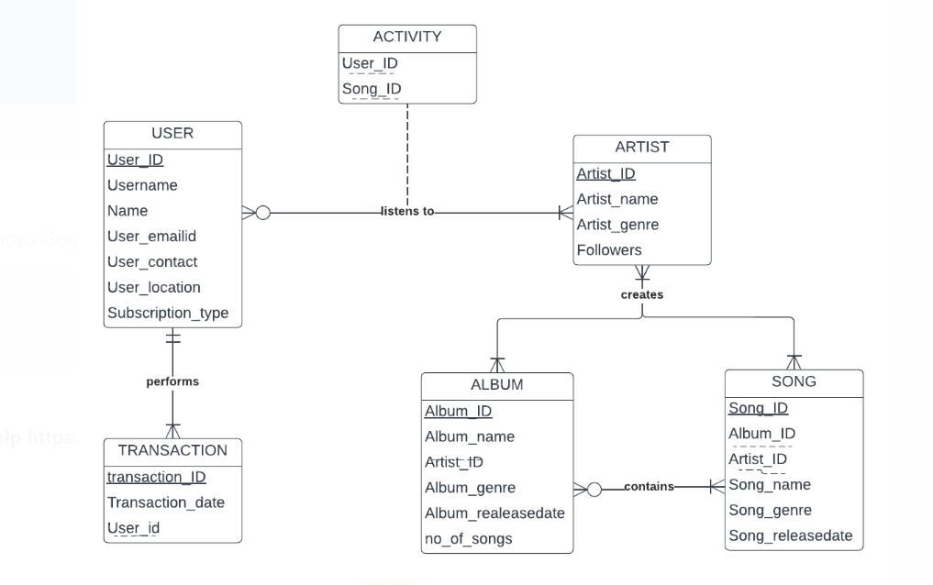
ENTITY RELATIONSHIP MODEL

Slide 5
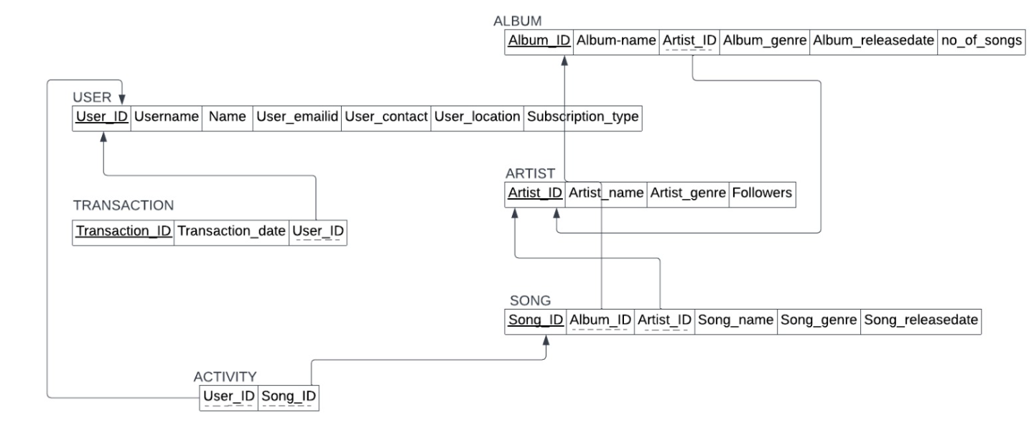
RELATIONAL DATABASE MODEL

Slide 6
Entity : USER
Attributes :
User_ID
Username
Name
User_emailid
User_contact
User_location
Subscription_type
This entity contains data of the User’s information like ID, Username, name, contact information and subscription type.
Here, User_ID is the primary key.

Slide 7
Entity : TRANSACTION
Attributes :
Transaction_ID
Date
User_ID
This entity contains data of the User’s Transaction needed to subscribe to the apple music.
Here, Transaction_ID is the primary key and User_ID is the foreign key.

Slide 8
Entity : ARTIST
Attributes :
Artist_ID
Artist_Name
Artist_genre
Followers
This entity contains data of the Artist like its ID, Name, genre type and number of followers.
Here, Artist_ID is the primary key.
User can listen to a particular artist.

Slide 9
Entity : ALBUM
Attributes :
Album_ID
Album_Name
Artist_ID
Album_genre
Album_releasedate
no_of_songs
This entity contains data of the Album, the user is searching and has attributes like ID, name, genre, its release date and number of songs in that album.
Here, Album_ID is the primary key and Artist_ID is the foreign key.
Artist creates an album.

Slide 10
Entity : SONG
Attributes :
Song_ID
Album_ID
Artist_ID
Song_Name
Song_genre
Song_releasedate
This entity contains data of the Songs being searched by the user.
Here, Song_ID is the primary key and Album_ID and Artist_ID are the foreign keys.
An artist creates songs and an album contains a song.

Slide 11
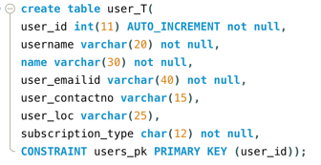
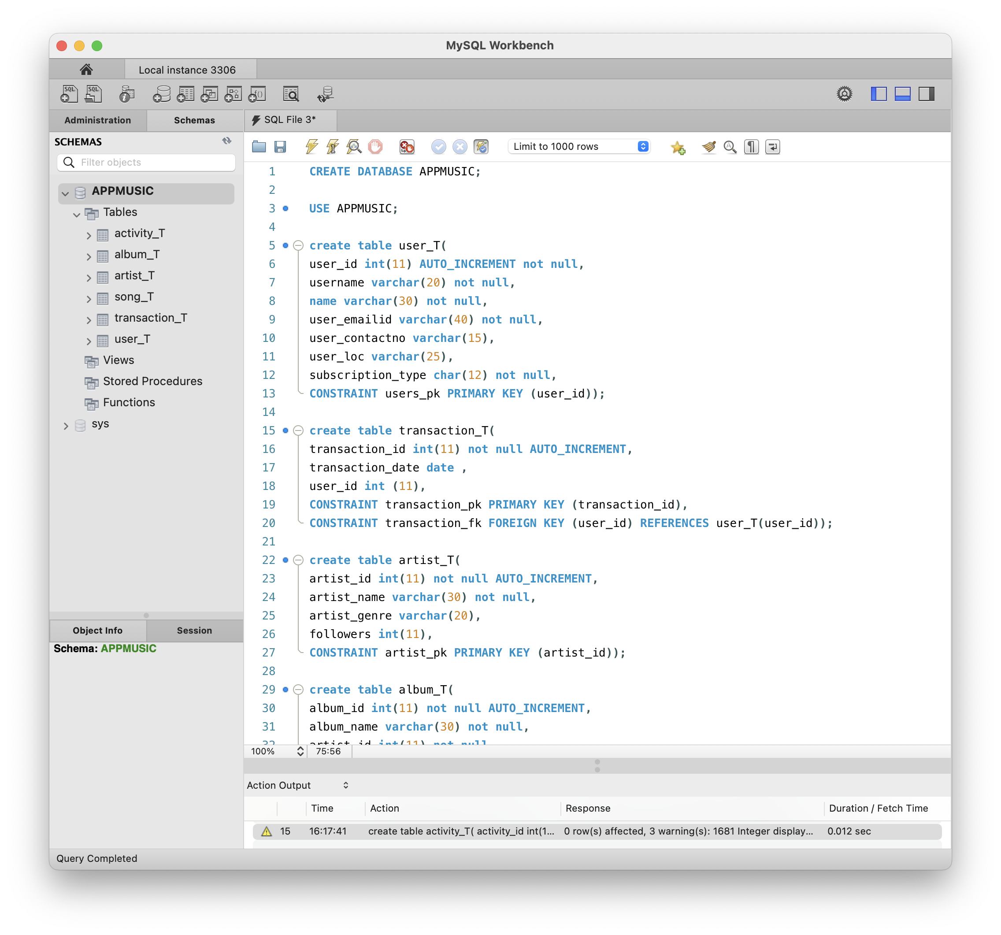
mySQL implementation- Create Tables

Slide 12
mySQL implementation- Create Tables

Slide 13
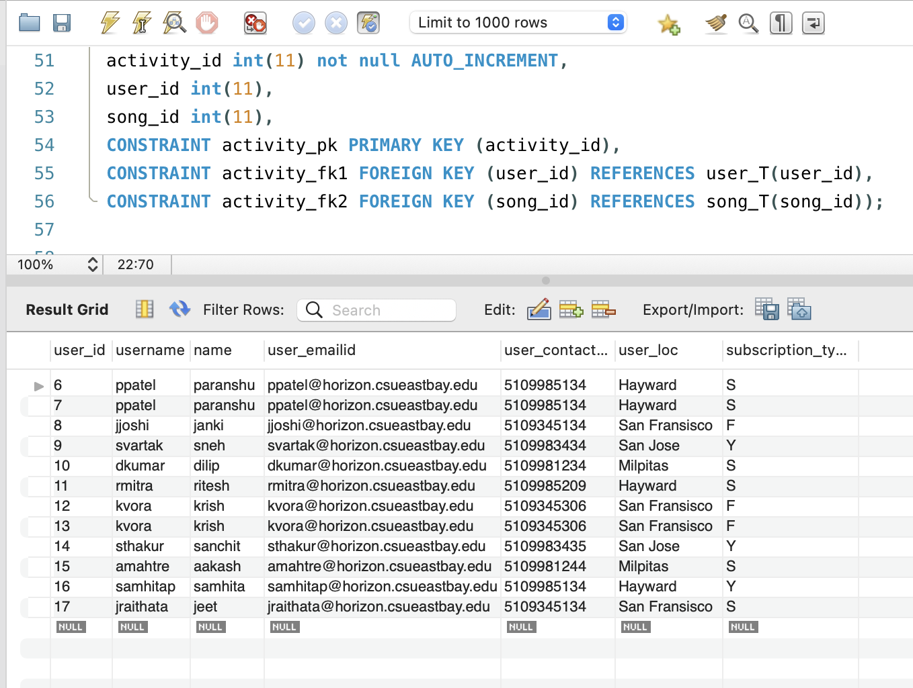
mySQL implementation- Insert Values in Tables

Slide 14
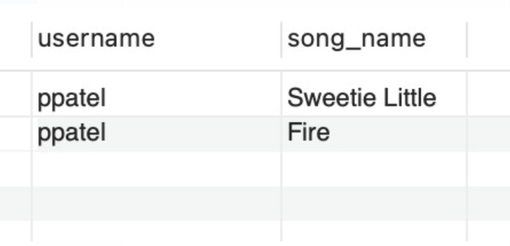
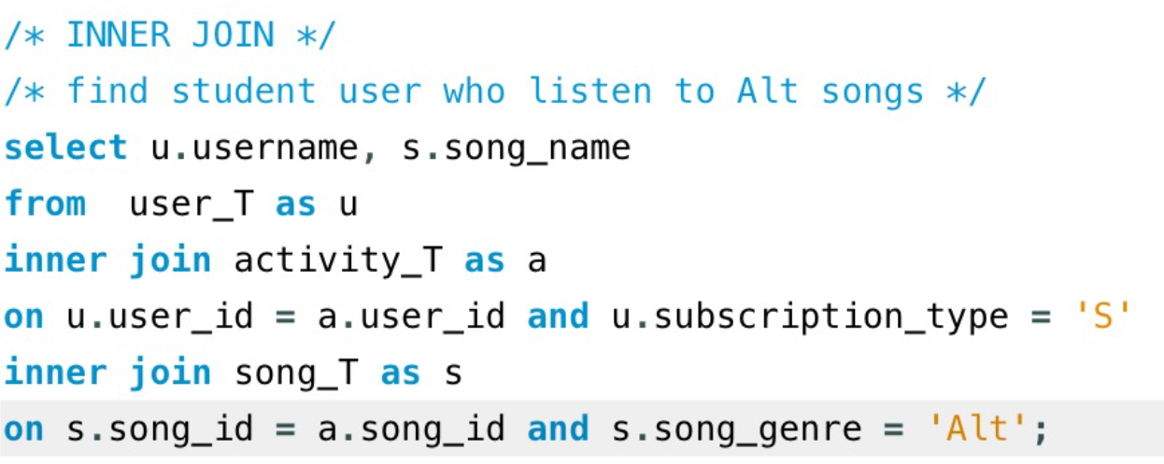
JOINS

Slide 15
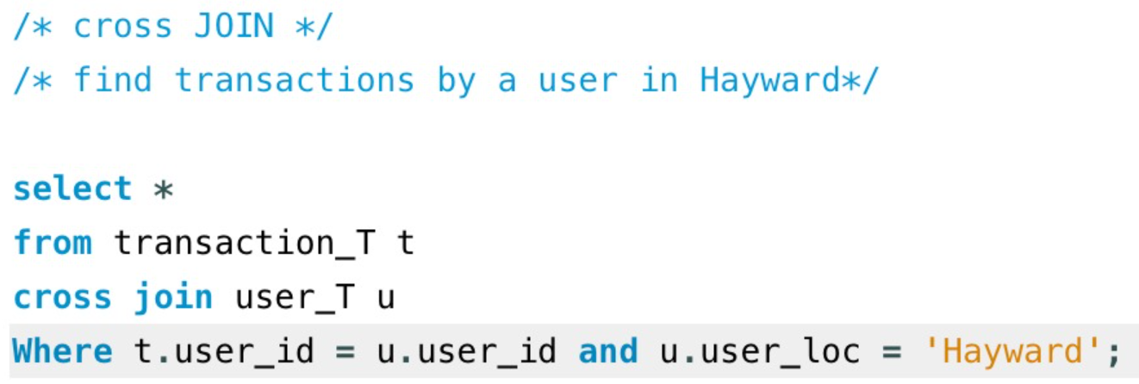
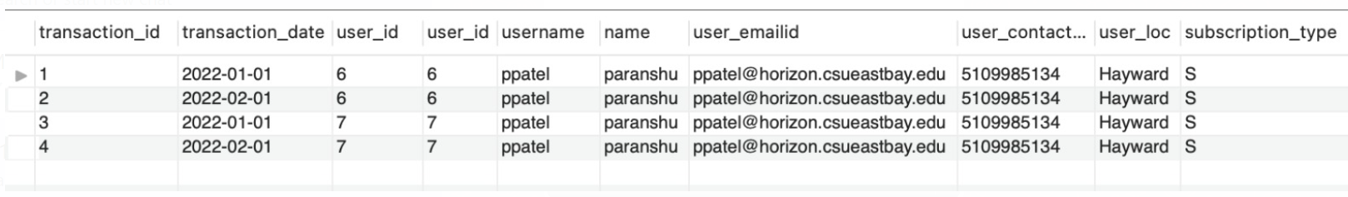
JOINS

Slide 16
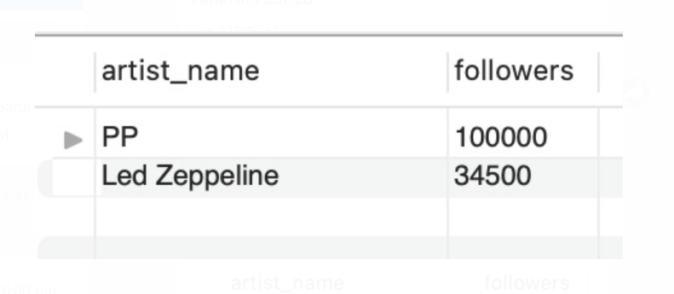
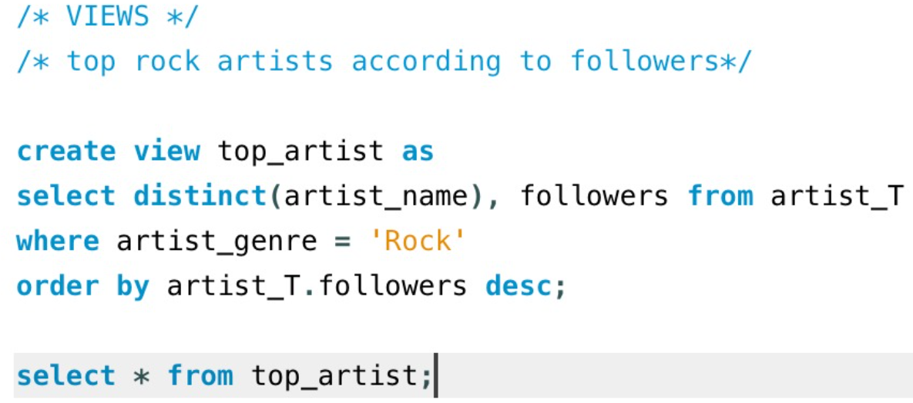
VIEWS
Display artists who composes Rock songs according to their followers.

Slide 17
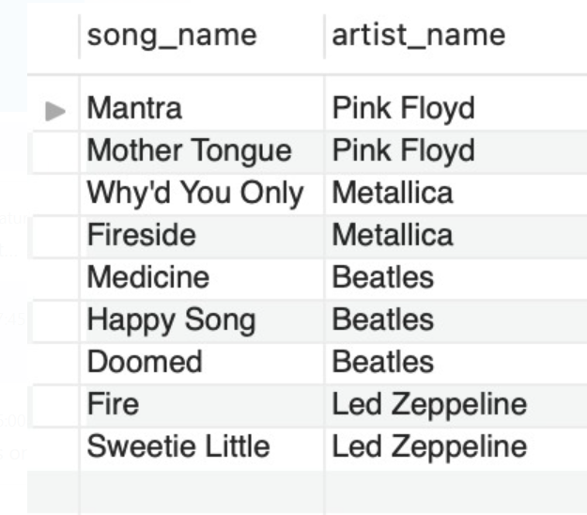
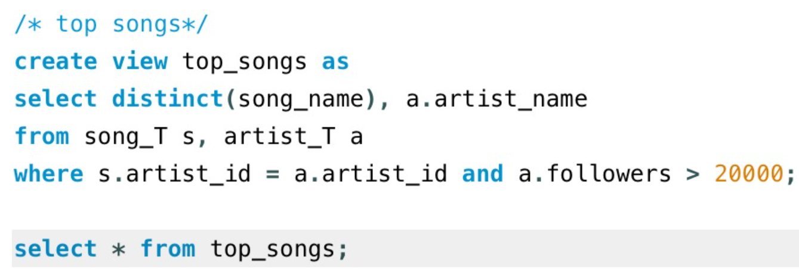
VIEWS
Display top songs based on the number of followers

